Slide 1
Few-shot learning
State of the Art
Joseph Shtok
IBM Research AI
The presentation is available at http://www.research.ibm.com/haifa/dept/imt/ist_dm.shtml

Slide 2
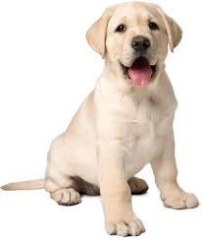
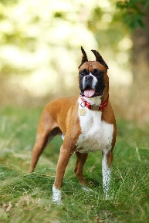
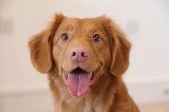
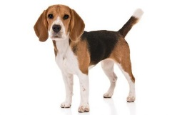
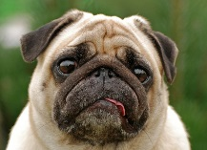
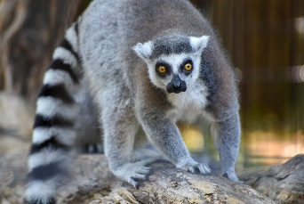
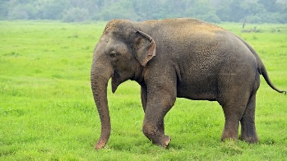
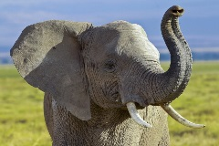
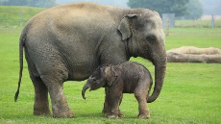
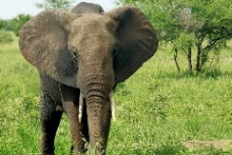
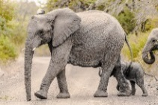
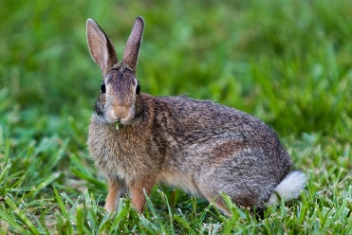
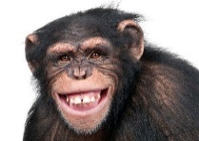
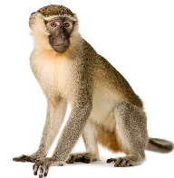
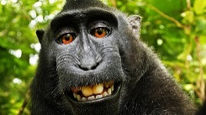
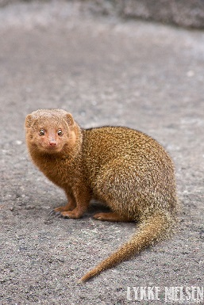
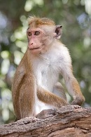
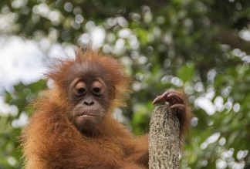
Problem statement
given task
Using a large annotated offline dataset,
perform for novel categories, represented by just a few samples each.
dog
lemur
knowledge transfer
model for novel categories
elephant
…
Online training
rabbit
Offline training
monkey
mongoose

Slide 3
Problem statement
classification
Using a large annotated offline dataset,
perform for novel categories, represented by just a few samples each.
dog
lemur
knowledge transfer
classifier for novel categories
elephant
…
Online training
rabbit
Offline training
monkey
mongoose

Slide 4
Problem statement
detection
Using a large annotated offline dataset,
perform for novel categories, represented by just a few samples each.
dog
lemur
knowledge transfer
detector for novel categories
elephant
…
Online training
rabbit
Offline training
monkey
mongoose

Slide 5
Problem statement
regression
Using a large annotated offline dataset,
perform for novel categories, represented by just a few samples each.
dog
lemur
knowledge transfer
regressor for novel categories
elephant
…
Online training
rabbit
Offline training
monkey
mongoose

Slide 6
Why work on few-shot learning?
It brings the DL closer to real-world business usecases.
Companies hesitate to spend much time and money on annotated data for a solution that they may profit.
Relevant objects are continuously replaced with new ones. DL has to be agile.
2. It involves a bunch of exciting cutting-edge technologies.
Data synthesizers
Meta-learning methods
Neural Turing Machines
GANs
Semantic metric spaces
Networks generating networks
Graph neural networks

Slide 7
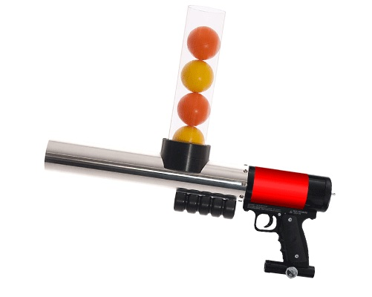

Meta-learning
Learn a learning strategy to adjust well to a new few-shot learning task
Metric learning
Learn a `semantic` embedding space using a distance loss function
Few-shot learning
Learn to perform classification, detection, regression
Each category is represented by just a few examples
Data augmentation
Synthesize more data from the novel classes to facilitate the regular learning

Slide 8
Meta-Learning
training a learner on the data
task-specific
data
data
model
Standard learning:
data instances
data knowledge
model
meta-learner
data
data
specific classes
training data
target data
task data
learner
New task
data
Training a meta learner to learn on each task
learning strategy
Meta learning:
data
tasks
meta-learner
task-agnostic
task-specific
model
Notes:
Meta learning: “learn on other problems how to improve learning for our target problem”

Slide 9
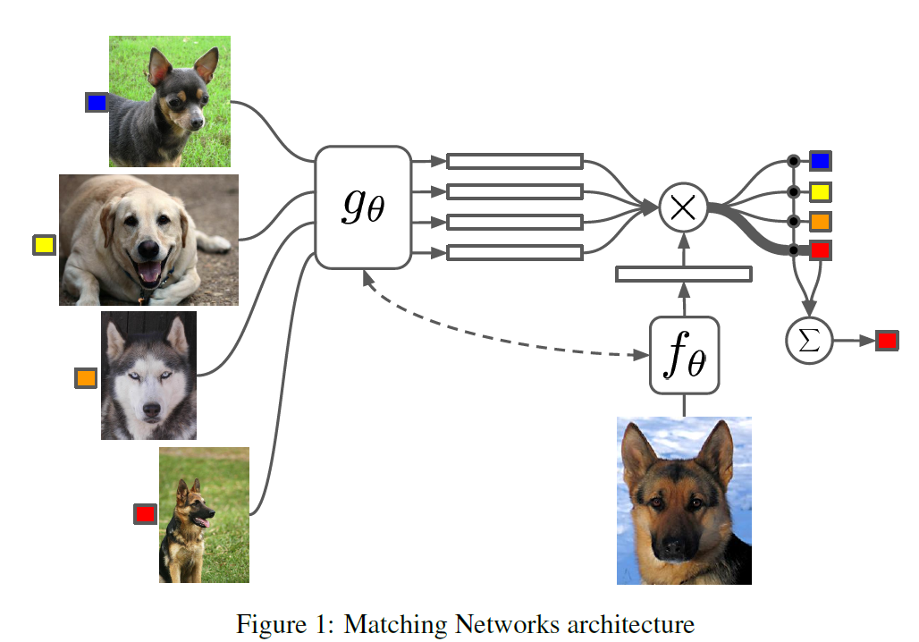
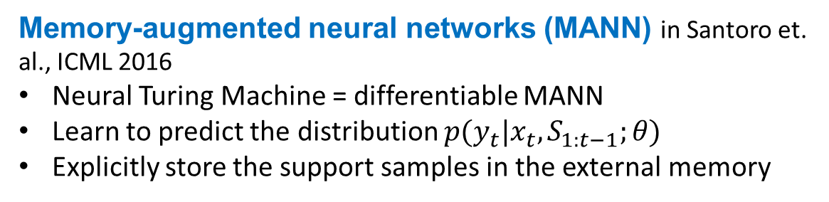
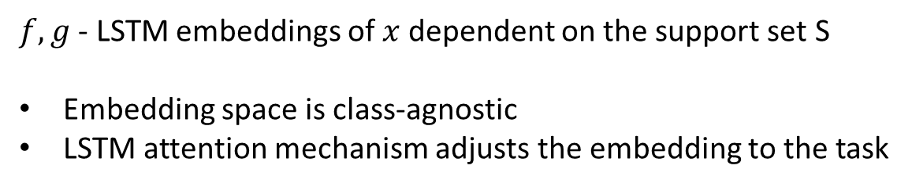
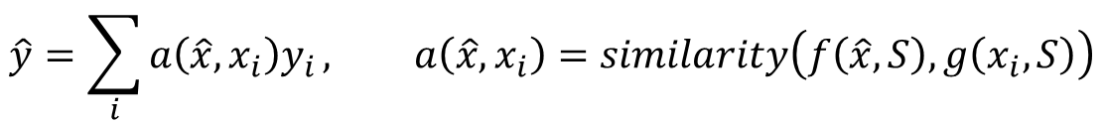
Recurrent meta-learners
Matching Networks in Vinyals et.al., NIPS 2016
Distance-based classification: based on similarity between the query and support samples in the embedding space (adaptive metric):
$$\hat{y}=\sum_{i}{a\left(\hat{x},x_{i}\right)y_{i}}, a\left(\hat{x},x_{i}\right)=similarity\left(f\left(\hat{x},S\right),g\left(x_{i},S\right)\right)$$
to be elaborated later
$f,g$ - LSTM embeddings of $x$ dependent on the support set S
Embedding space is class-agnostic
LSTM attention mechanism adjusts the embedding to the task
reprinted from Vinyals et.al., 2016
Method | miniImageNet classification accuracy 1/5 shot
Matching networks | 43.56 / 55.31
Concept of episodes: test conditions in the training.
N new categories
M training examples per category
one query example in {1..N} categories.
Typically, N=5, M=1, 5.
Memory-augmented neural networks (MANN) in Santoro et. al., ICML 2016
Neural Turing Machine = differentiable MANN
Learn to predict the distribution $p(y_{t}|x_{t}, S_{1:t−1};θ)$
Explicitly store the support samples in the external memory
Notes:
References:
Oriol Vinyals, Charles Blundell, Timothy Lillicrap, Koray Kavukcuoglu, and Daan Wierstra, Matching networks for one shot learning. In NIPS 2016
Adam Santoro, Sergey Bartunov, Matthew Botvinick, Daan Wierstra, and Timothy Lillicrap, Meta-Learning with Memory-Augmented Neural Networks, ICML 2016

Slide 10
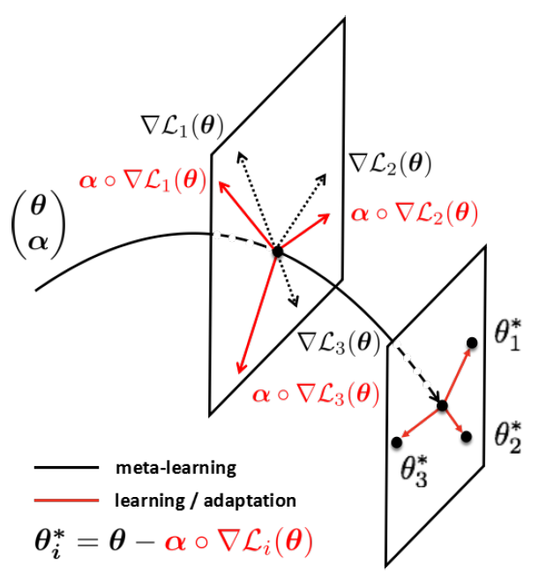
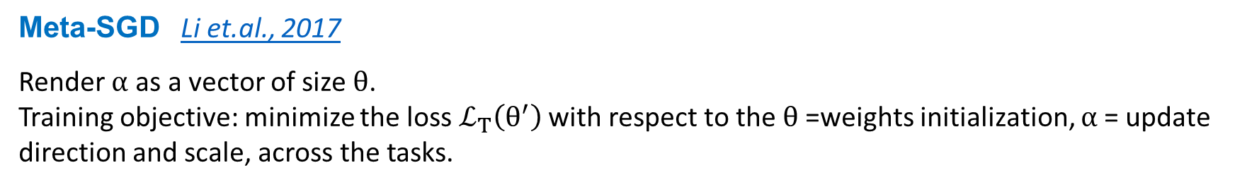
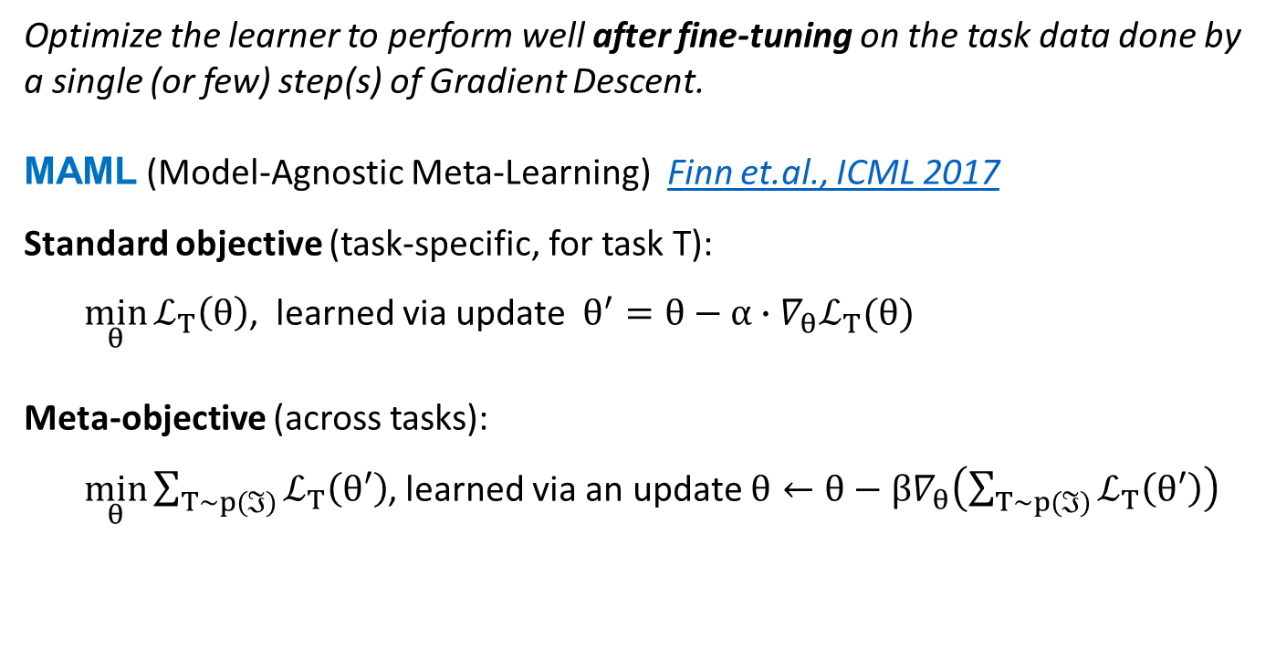
Optimizers
Optimize the learner to perform well after fine-tuning on the task data done by a single (or few) step(s) of Gradient Descent.
MAML (Model-Agnostic Meta-Learning) Finn et.al., ICML 2017
Standard objective (task-specific, for task T):
$\min_{θ}{ℒ_{T}\left(θ\right)}$, learned via update $θ^{′}=θ−α∙∇_{θ}ℒ_{T}(θ)$
Meta-objective (across tasks):
$\min_{θ}{\sum_{T\sim p(ℑ)}{ℒ_{T}\left(θ′\right)}}$, learned via an update $θ←θ−β∇_{θ}\left(\sum_{T\sim p(ℑ)}{ℒ_{T}\left(θ′\right)}\right)$
Method | miniImageNet classification accuracy 1/5 shot
Matching networks | 43.56 / 55.31
MAML | 48.70 / 63.11
Meta-SGD | 54.24 / 70.86
reprinted from Li et.al., 2017
Meta-SGD Li et.al., 2017
“Interestingly, the learning process can continue forever, thus enabling life-long learning, and at any moment, the meta-learner can be applied to learn a learner for any new task.”
Meta-SGD Li et.al., 2017
Render $α$ as a vector of size $θ$. Training objective: minimize the loss $ℒ_{T}\left(θ^{′}\right)$ with respect to the $θ$=weights initialization, $α$= update direction and scale, across the tasks.
Notes:
References:
Finn, Chelsea, Pieter Abbeel, and Sergey Levine. Model-agnostic meta-learning for fast adaptation of deep networks. Proceedings of the 34th International Conference on Machine Learning-Volume 70. JMLR. org, 2017
Li2017 - Z. Li, F. Zhou, F. Chen, and H. Li. Meta-SGD: Learning to Learn Quickly for Few-Shot Learning. arXiv:1707.09835, 2017

Slide 11
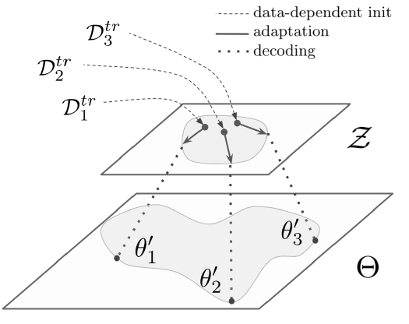

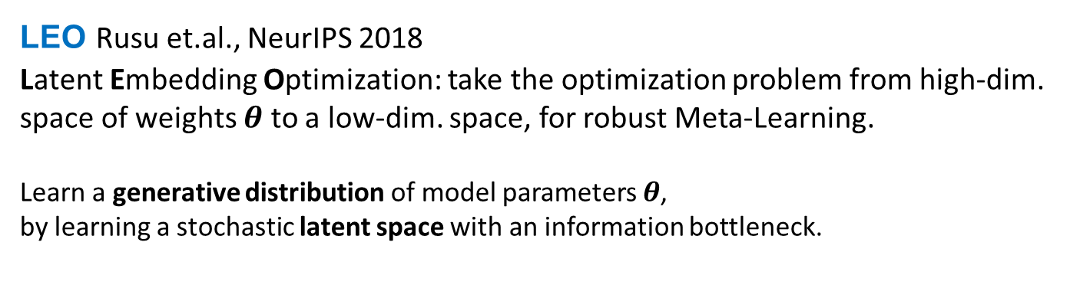
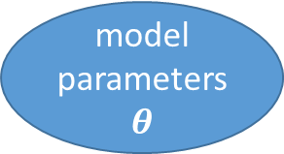
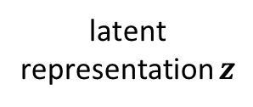
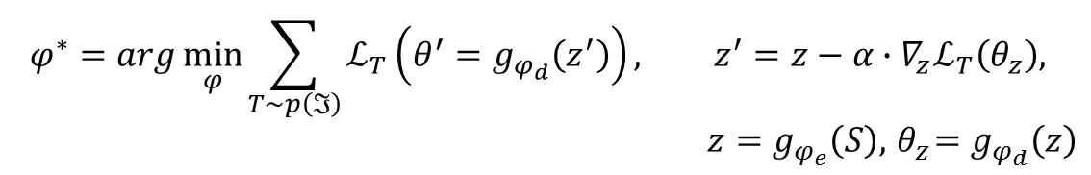

Optimizers
LEO Rusu et.al., NeurIPS 2018
Latent Embedding Optimization: take the optimization problem from high-dim. space of weights $θ$ to a low-dim. space, for robust Meta-Learning.
Learn a generative distribution of model parameters $θ$, by learning a stochastic latent space with an information bottleneck.
$$φ^{∗}=arg\min_{φ}{\sum_{T\sim p\left(ℑ\right)}{ℒ_{T}\left(θ^{′}=g_{φ_{d}}\left(z^{′}\right)\right)}}, z^{′}=z−α∙∇_{z}ℒ_{T}\left(θ_{z}\right),$$
$$z=g_{φ_{e}}\left(S\right),{ θ}_{z}=g_{φ_{d}}\left(z\right)$$
Method | miniImageNet classification accuracy 1/5 shot
Matching networks | 43.56 / 55.31
MAML | 48.70 / 63.11
Meta-SGD | 54.24 / 70.86
LEO | 61.76 / 77.59
stochastic encoder
parameter generator
data
model parameters $θ$
data
$$φ_{e}$$
$$φ_{d}$$
data instances
latent representation $z$
Relation network encodes distances between elements of support set for a new task
Notes:
Andrei A. Rusu and Dushyant Rao and Jakub Sygnowski and Oriol Vinyals and Razvan Pascanu and Simon Osindero and Raia Hadsell, Meta-Learning with Latent Embedding Optimization, NeurIPS 2018

Slide 12

Metric Learning
deep embedding model
data
semantic embedding space
data
data instances
classification
Offline training
class 1
New task data
class A
d(q,A)
d(q,C)
query
d(q,B)
class 3
class C
class 2
class B
Training: achieve good distributions for offline categories
Inference: Nearest Neightbour in the embedding space

Slide 13
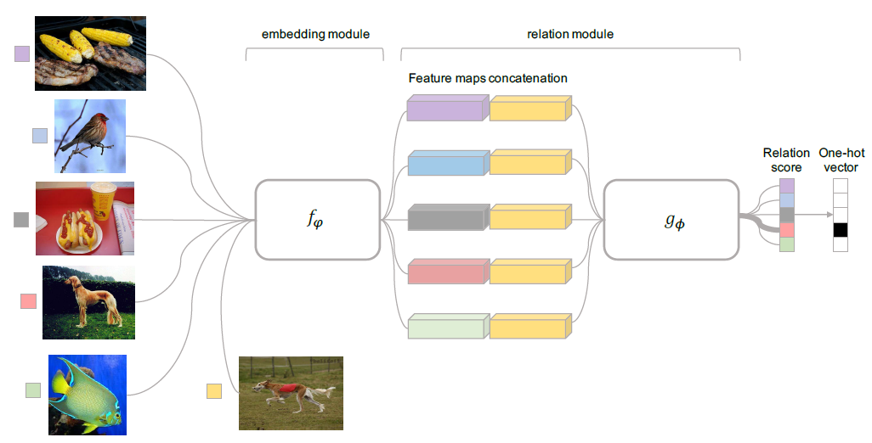
Metric Learning
Relation networks, Sung et.al., CVPR 2018
Use the Siamese Networks principle :
Concatenate embeddings of query and support samples
Relation module is trained to produces score 1 for correct class and 0 for others
Extends to zero-shot learning by replacing support embeddings with semantic features.
Method | miniImageNet classification accuracy 1/5 shot
Matching networks | 43.56 / 55.31
MAML | 48.70 / 63.11
Relation networks | 50.44 / 65.32
Meta-SGD | 54.24 / 70.86
LEO | 61.76 / 77.59
replicated from Sung et.al., Learning to Compare - Relation network for few-shot learning, CVPR 2018
Notes:
References
Sung, Flood & Yang, Yongxin & Zhang, Li & Xiang, Tao & H. S. Torr, Philip & Hospedales, Timothy. Learning to Compare: Relation Network for Few-Shot Learning. CVPR 2018

Slide 14
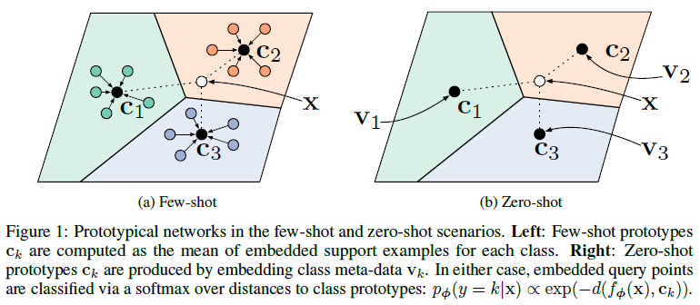
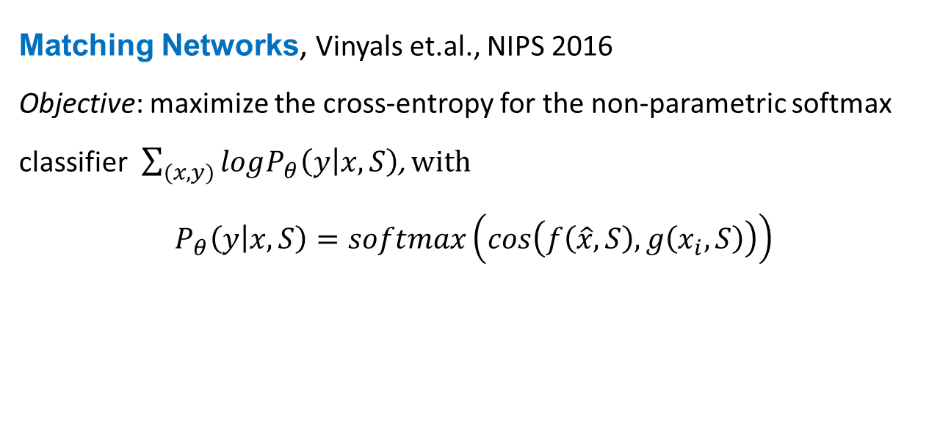
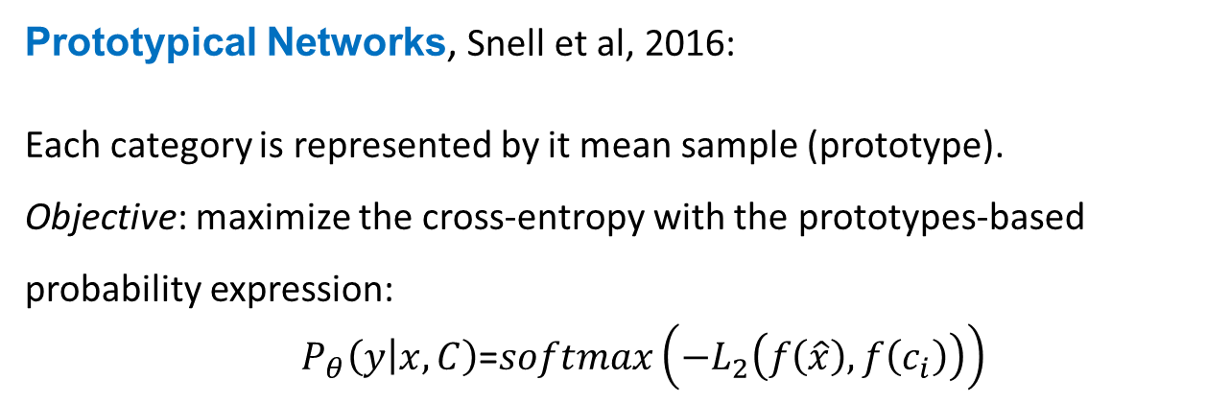
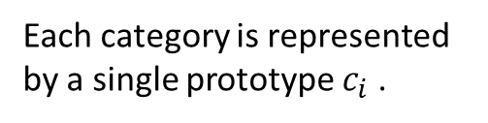
Metric Learning
Matching Networks, Vinyals et.al., NIPS 2016 Objective: maximize the cross-entropy for the non-parametric softmax classifier $\sum_{(x,y)}{logP_{θ}\left(y | x,S\right)}$, with
$$P_{θ}\left(y | x,S\right)=softmax\left(cos\left(f\left(\hat{x},S\right),g\left(x_{i},S\right)\right)\right)$$
Method | miniImageNet classification accuracy 1/5 shot
Matching networks | 43.56 / 55.31
MAML | 48.70 / 63.11
Relation networks | 50.44 / 65.32
Prototypical Networks | 49.42 / 68.20
Meta-SGD | 54.24 / 70.86
LEO | 61.76 / 77.59
Prototypical Networks, Snell et al, 2016:
Each category is represented by it mean sample (prototype).
Objective: maximize the cross-entropy with the prototypes-based probability expression:
$P_{θ}\left(y | x,C\right)$=$softmax\left(−L_{2}\left(f\left(\hat{x}\right),f\left(c_{i}\right)\right)\right)$
Each category is represented by a single prototype $c_{i}$ .

Slide 15
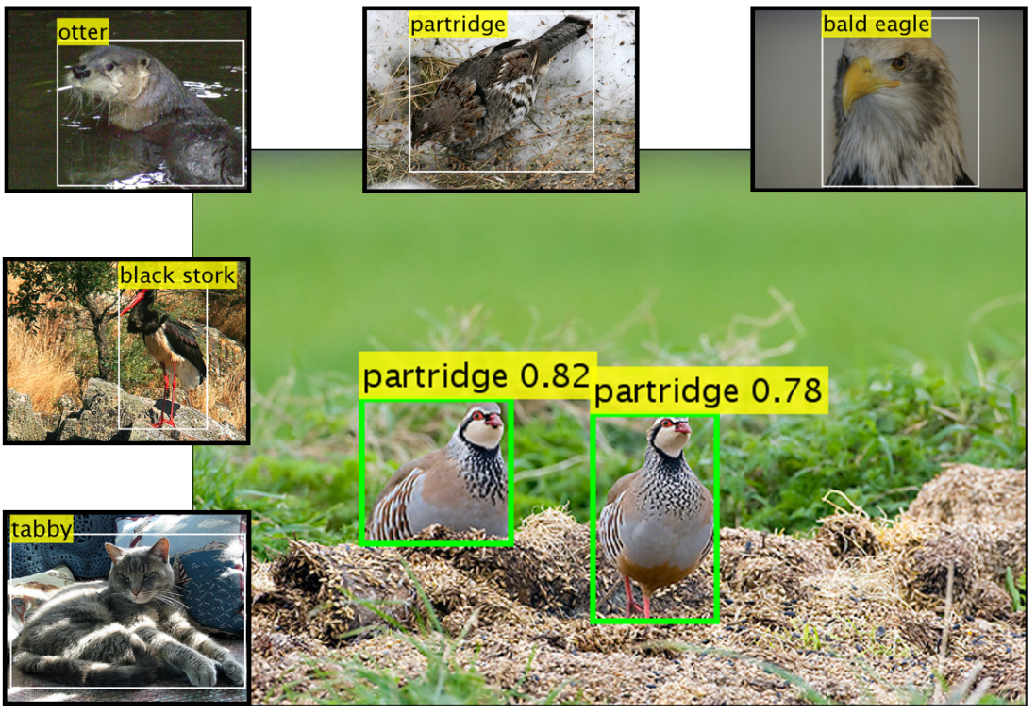
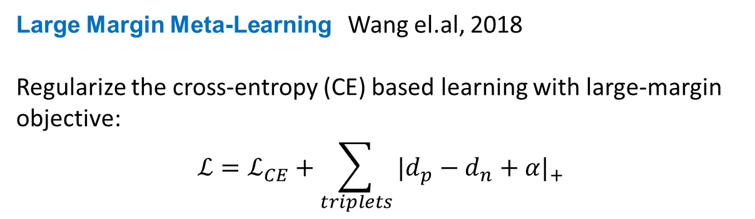
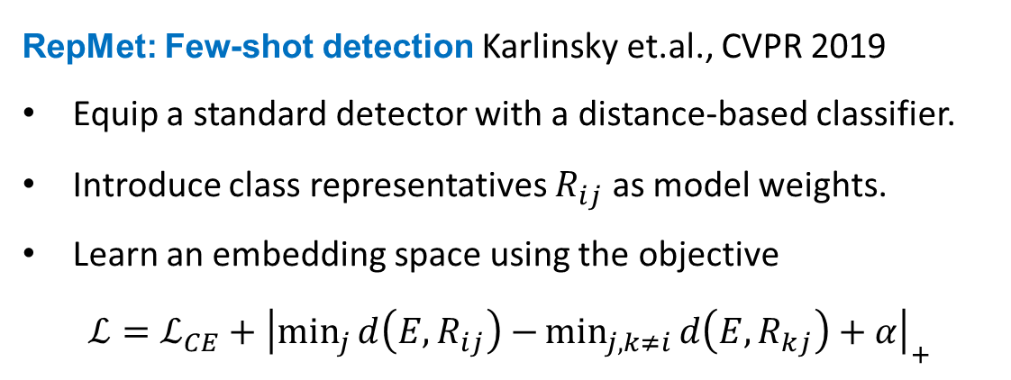
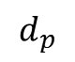
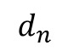
Metric Learning
Method | miniImageNet classification accuracy 1/5 shot
Matching networks | 43.56 / 55.31
MAML | 48.70 / 63.11
Relation networks | 50.44 / 65.32
Prototypical Networks | 49.42 / 68.20
Large-margin | 51.08 / 67.57
Meta-SGD | 54.24 / 70.86
LEO | 61.76 / 77.59
Distances for triplet loss
Large Margin Meta-Learning Wang el.al, 2018
Regularize the cross-entropy (CE) based learning with large-margin objective:
$$ℒ=ℒ_{CE}+\sum_{triplets}{{|d_{p}−d_{n}+α|}_{+}}$$
$$d_{p}$$
$$d_{n}$$
positive
sample
(hard)-negative
RepMet: Few-shot detection Karlinsky et.al., CVPR 2019
Equip a standard detector with a distance-based classifier.
Introduce class representatives $R_{ij}$ as model weights.
Learn an embedding space using the objective
$$ℒ=ℒ_{CE}+{\left|\min_{j}{d\left(E,R_{ij}\right)−}\min_{j,k≠i}{d\left(E,R_{kj}\right)+α}\right|}_{+}$$
Notes:
Wang, Y., Wu, X.M., Li, Q., Gu, J., Xiang, W., Zhang, L. and Li, V.O., Large Margin Meta-Learning for Few-Shot Classification’, metalearning.ml

Slide 16


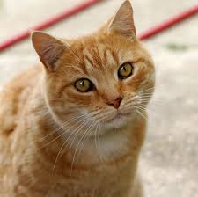


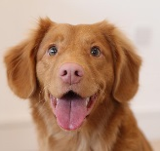

Sample synthesis
Offline stage
train a synthesizer sampling from class distribution
synthesizer model
data
data
data instances
data knowledge
On new task data
synthesizer model
train a model
task model
data
data
few data instances
data
many data instances
novel classes
data
data
offline data

Slide 17
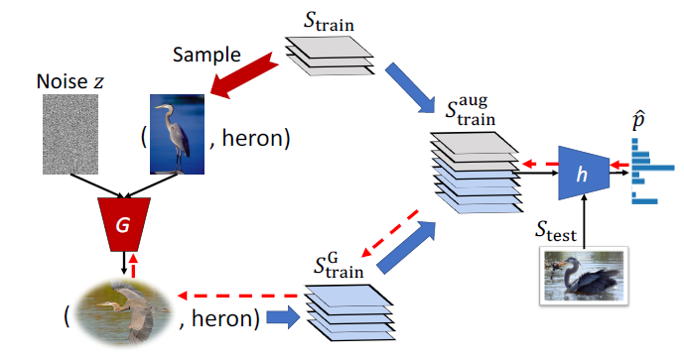
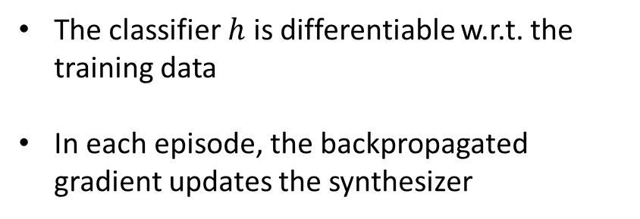
Synthesizer optimized for classification
Low-Shot Learning from Imaginary Data
Wang et.al., 2018
The synthesizer is a part of classifier pipeline, trained end-to end
The classifier $h$ is differentiable w.r.t. the training data
In each episode, the backpropagated gradient updates the synthesizer
Method | ImageNet top5 classification accuracy 1/5 shot
 | Novel | Base+Novel
Wang et.al., 2018 | 43.3 / 68.4 | 55.8 / 71.1
reprinted from Wang et.al., 2018
Notes:
Yu-Xiong Wang, Ross Girshick, Martial Hebert, Bharath Hariharan, Low-Shot Learning from Imaginary Data, Arxiv 2018

Slide 18




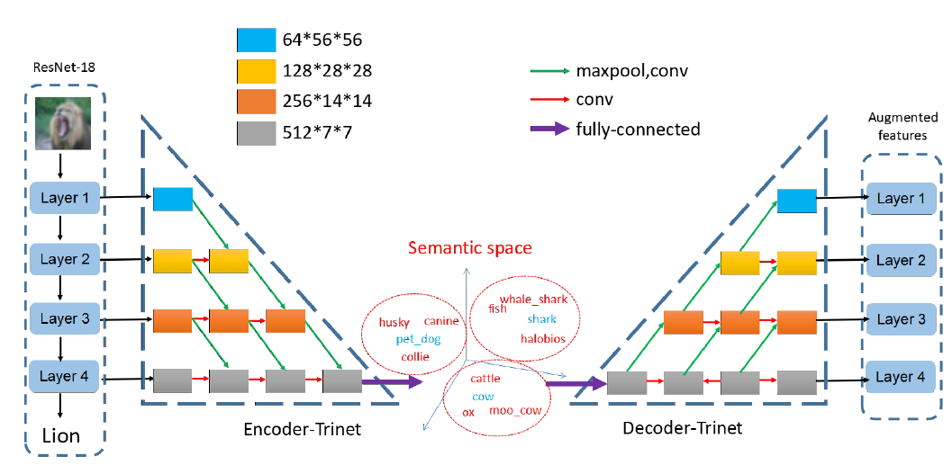
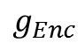
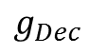
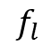

More augmentation approaches
Synthesis
Δ-encoder Schwartz et.al., NeurIPS 2018
Use a variant of autoencoder to capture the intra-class difference between two class samples in the latent space.
Transfer class distributions from training to novel classes.
Method | miniImageNet classification accuracy 1/5 shot
Matching networks | 43.56 / 55.31
MAML | 48.70 / 63.11
Relation networks | 50.44 / 65.32
Prototypical Networks | 49.42 / 68.20
Large-margin | 51.08 / 67.57
Meta-SGD | 54.24 / 70.86
Semantic Feat. Aug. | 58.12 / 76.92
Δ-encoder | 59.9 / 66.7
LEO | 61.76 / 77.59
Sampled target
Sampled reference
Encoder
Sampled
delta
$$Z$$
Decoder
Synthesized new class example
New class reference
Semantic Feature Augmentation in Few-shot Learning, Chen et.al., 2018
Synthesize samples by adding noise in the autoencoder’s bottleneck space.
Make it into a semantic space, using word embeddings or visual attributes for the objective’s fidelity term.
$$f_{l}$$
$$g_{Enc}$$
$$g_{Dec}$$
Notes:
Eliyahu Schwartz, Leonid Karlinsky, Joseph Shtok, Sivan Harary, Mattias Marder, Rogerio Feris, Abhishek Kumar, Raja Giryes and Alex M. Bronstein, 'Delta-encoder: an effective sample synthesis method for few-shot object recognition', NeurIPS 2018.
Chen, Z., Fu, Y., Zhang, Y., Jiang, Y. G., Xue, X., & Sigal, L. (2018). Semantic feature augmentation in few-shot learning. arXiv preprint arXiv:1804.05298

Slide 19
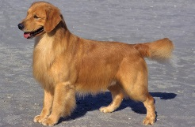







Augmentation with GANs
novel
Covariance-Preserving Adversarial Augmentation Networks Gao et.al., NIPS 2018
Act in in feature space. Generate samples for novel categories from offline categories, selected by proximity of samples.
Discriminate by classication:
cat
puma
…
fake
base
D
real image → correct class
synthetic image → ‘fake’
$$G_{n}$$
Method | ImageNet top5 classification accuracy 1/5 shot
 | Novel | Base+Novel
Wang et.al., 2018 | 43.3 / 68.4 | 55.8 / 71.1
Gao et.al., 2018 | 48.4 / 70.2 | 58.5 / 73.5
‘cat’
Cycle-consistency constraint:
$$G_{n}$$
$$G_{b}$$
Preserve the category distribution during transfer of base→ novel category.
Objective: penalize the difference between the two covariance matrices via Ky Fan m-norm, i.e., the sum of singular values of m-truncated SVD:
Notes:
Hang Gao, Zheng Shou, Alireza Zareian, Hanwang Zhang, Shih-Fu Chang, Low-shot Learning via Covariance-Preserving Adversarial Augmentation Networks, NIPS 2018

Slide 20

My personal view on the evolution of Machine Learning
Classic ML: One dataset, one task, one heavy training
Few-shot ML: Heavy offline training, then easy learning on similar tasks
Developing ML: continuous life-long learning on various tasks

Slide 21
Thank you
The presentation is available at http://www.research.ibm.com/haifa/dept/imt/ist_dm.shtml

